Slide 1

CS5004 Object-Oriented Design
Artillery Game
Group Members:
Yaozheng Wang
Guang Hu

Slide 2
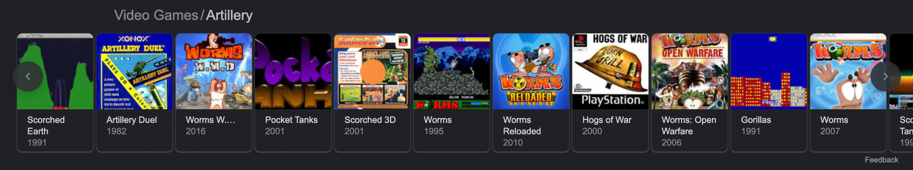
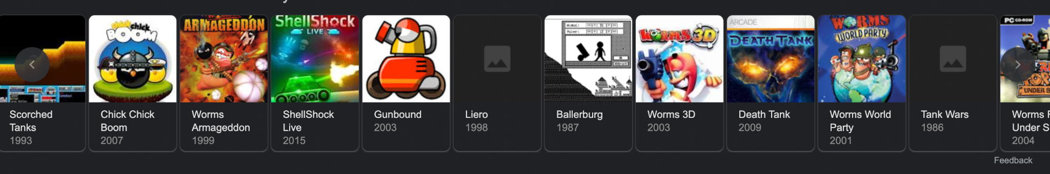
Design The Game

Slide 3
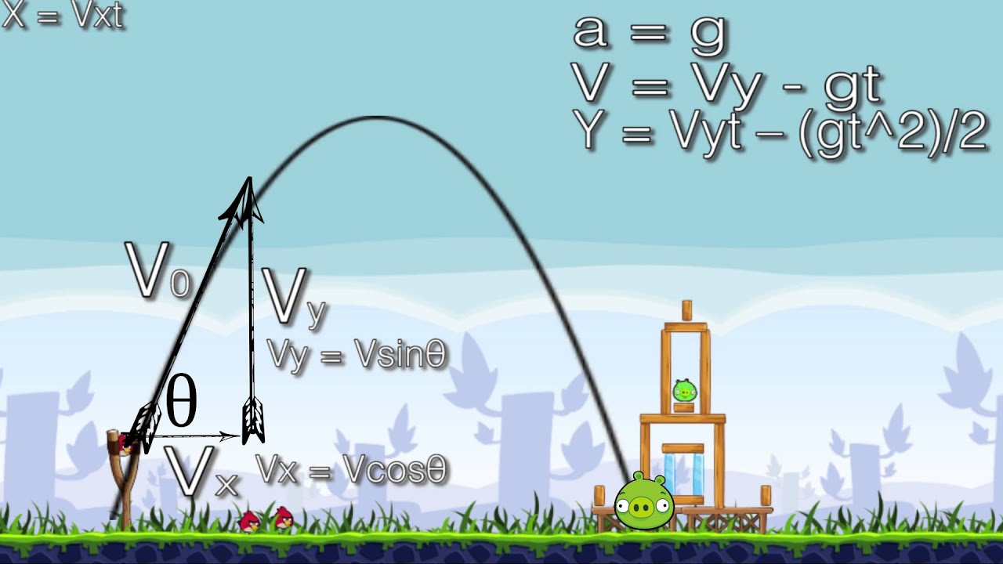
Design The Game

Slide 4
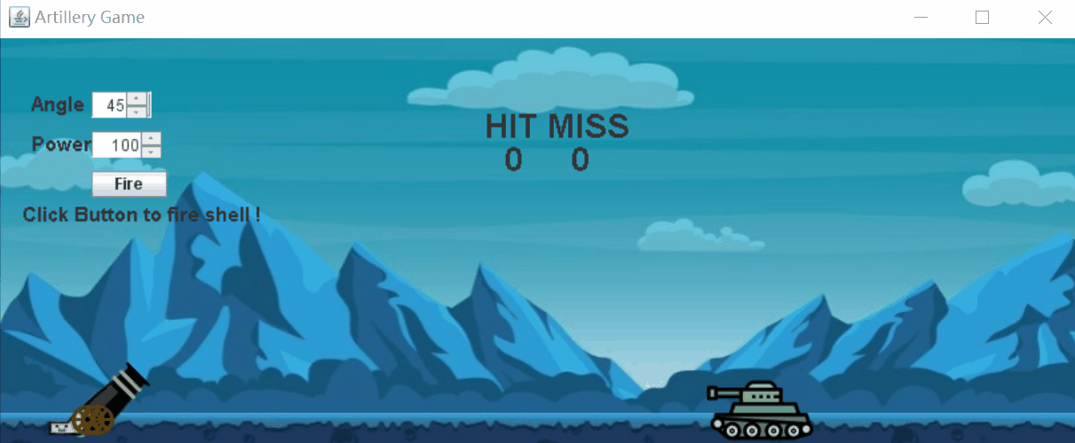
Design The Game - Core Mechanics
Goal: player find the way to destroy tank
Anticipate the trajectory, aim tank,
Input data values Control cannon, how to fire

Slide 5
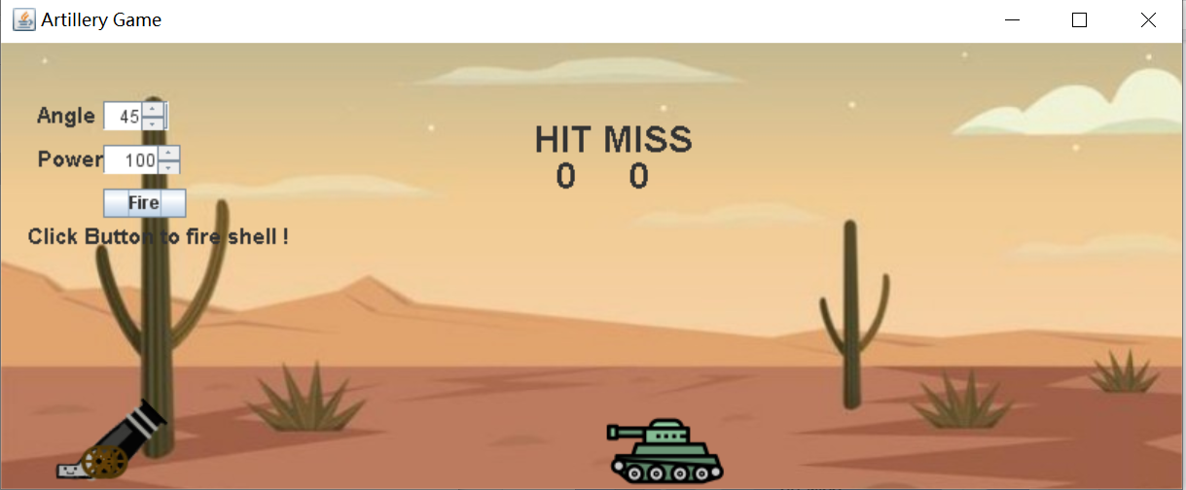
Design The Game - Layout
The cannon is on the left, the target is on the right
In each round, the location of the target is random
So the distance between the cannon and tank will change

Slide 6
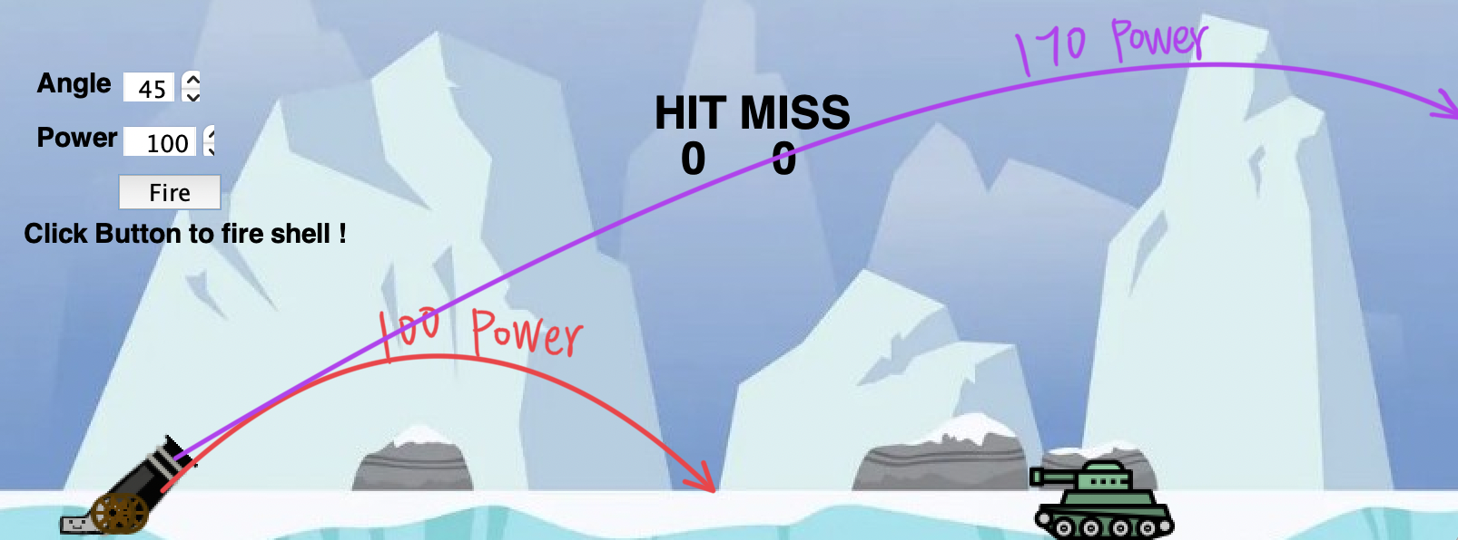
Design The Game - Each Round
The tank is located at a random distance from our cannon.
The player enter two parameters: angle and power.

Slide 7
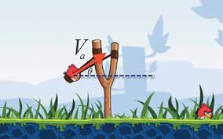
Design The Game

Slide 8
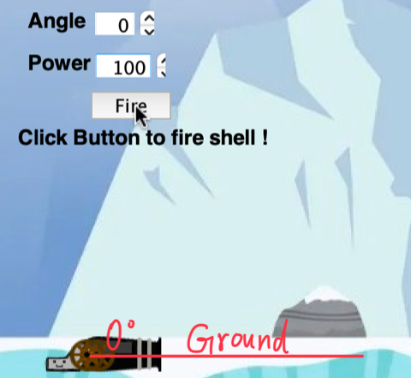
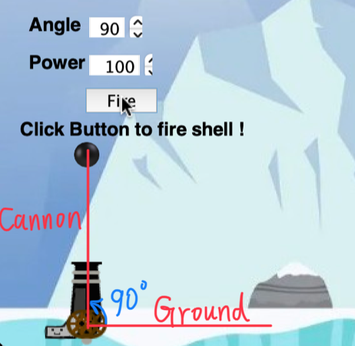
Design The Game - Core Mechanics
Angle defines the angle of the cannon.
Once the shell is launched, you can't change its power and angle

Slide 9
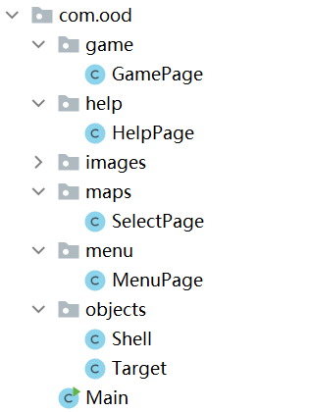
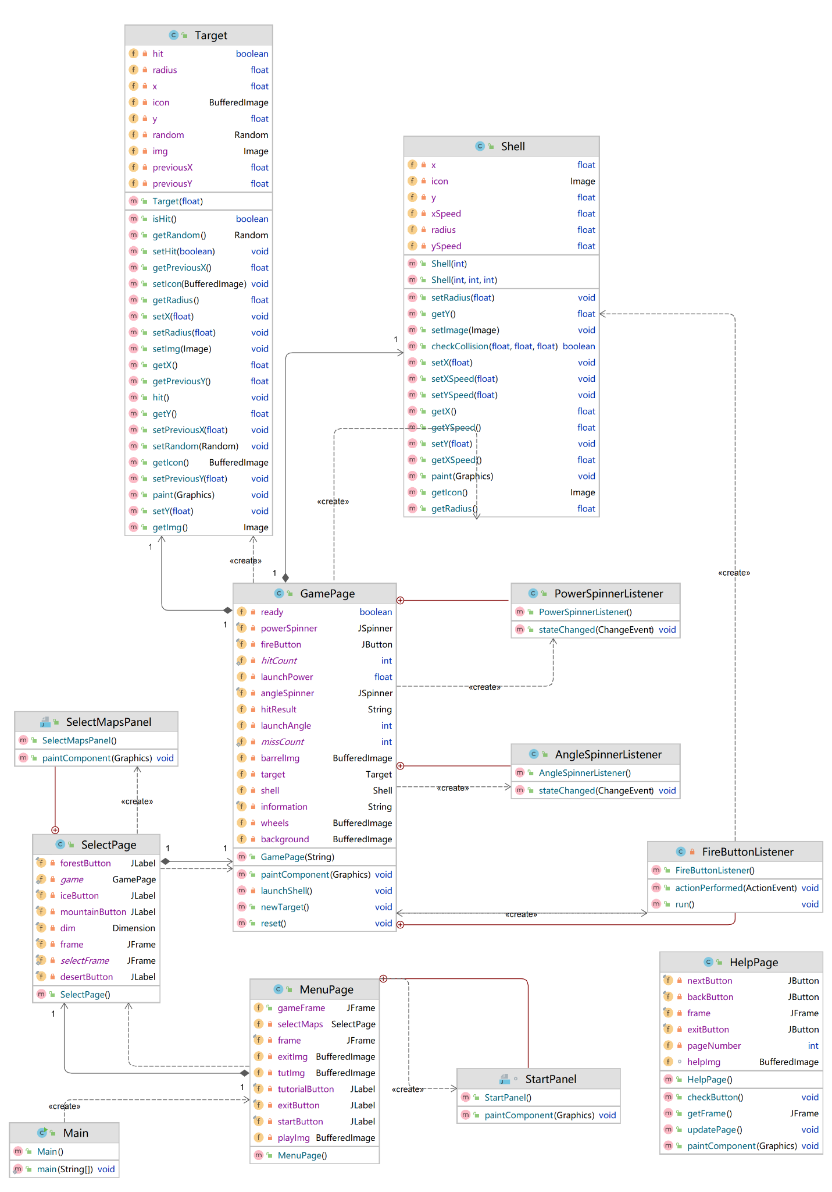
2. Game Structure
Package Structure
Class Relationship

Slide 10
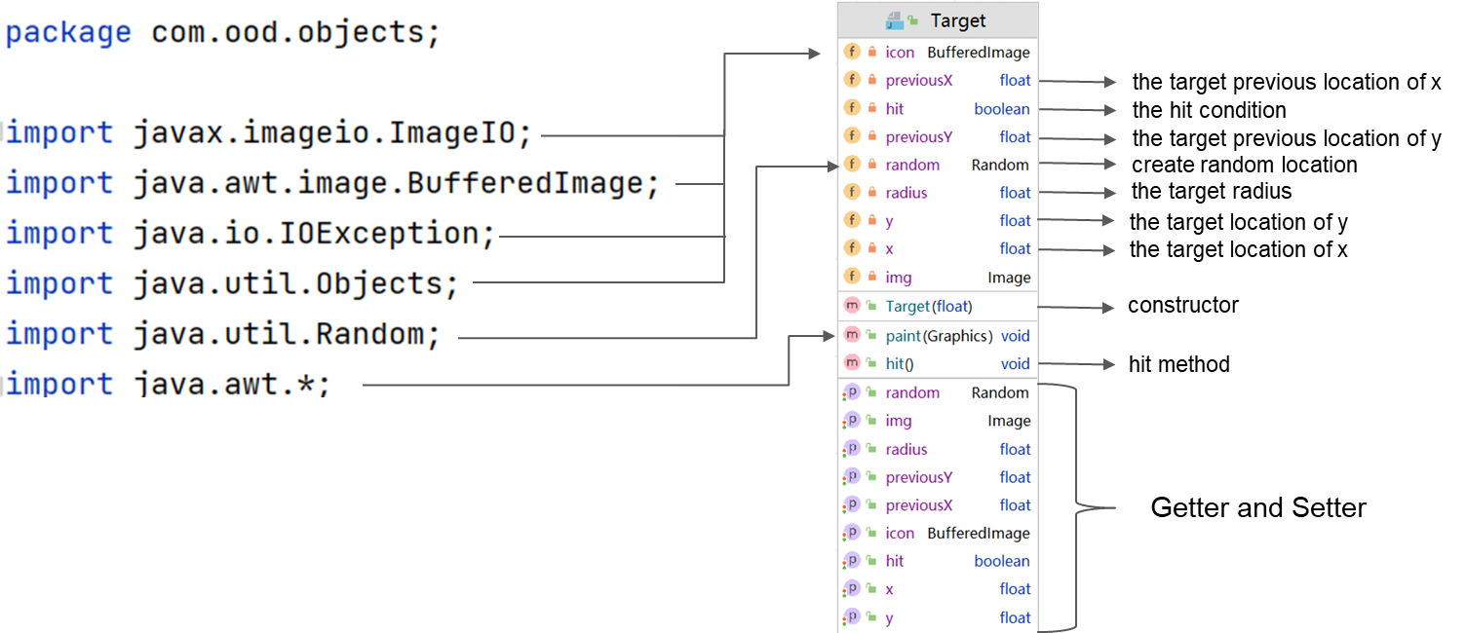
Game Structure - Target Class

Slide 11
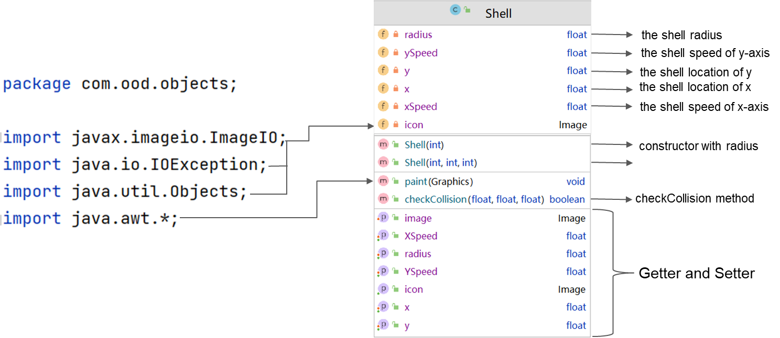
Game Structure - Shell Class
constructor with radius, x, y

Slide 12
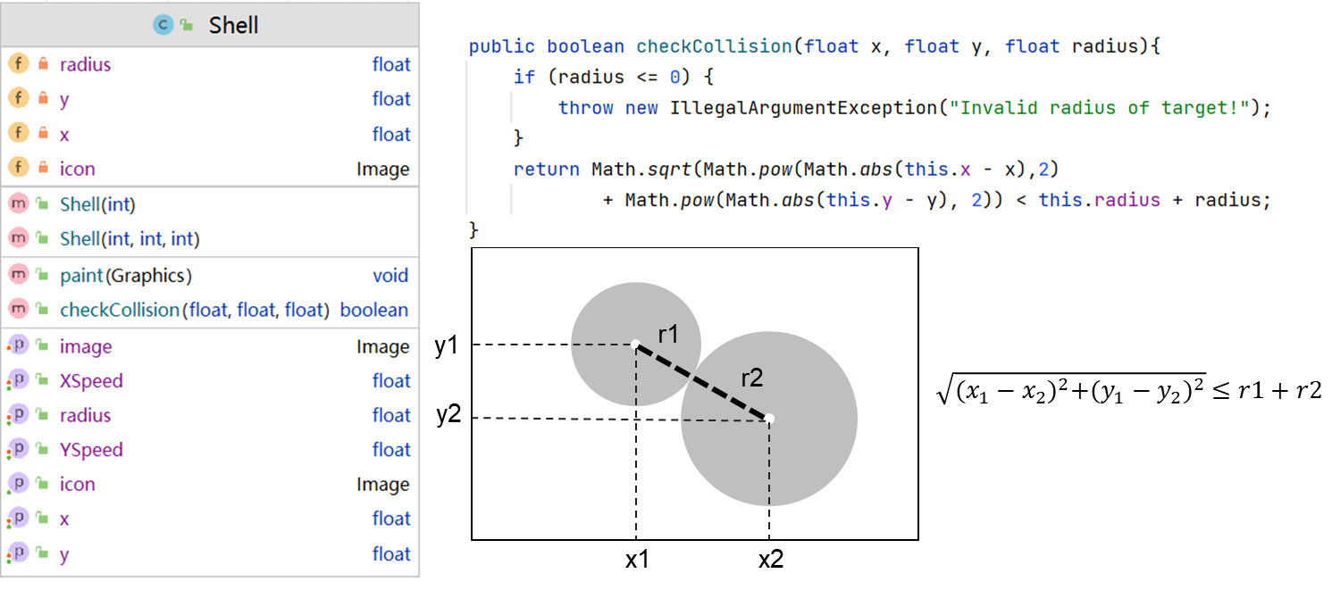
Game Structure - Shell Class
Hit the target
Miss target

Slide 13
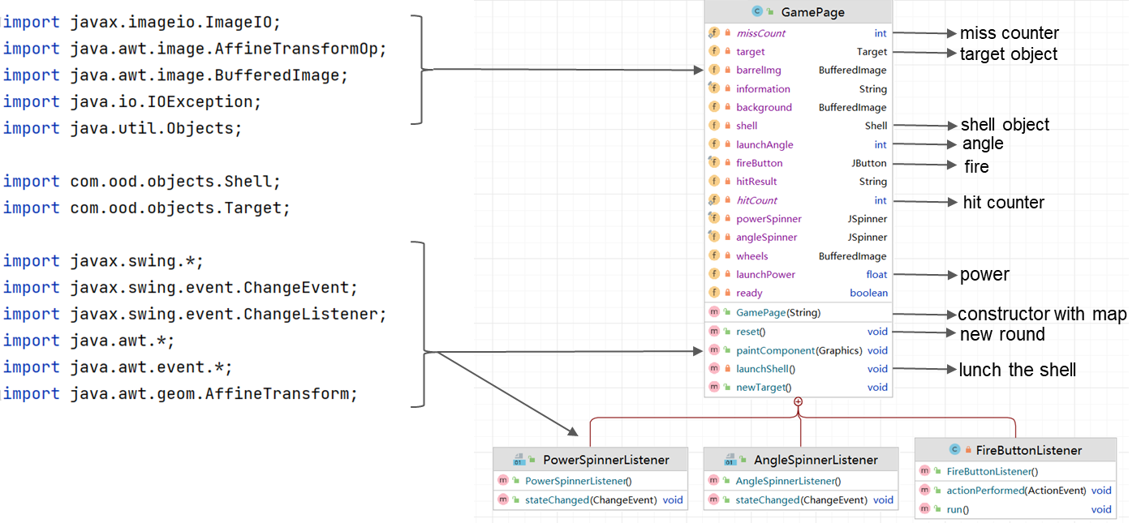
Game Structure - GamePage Class

Slide 14
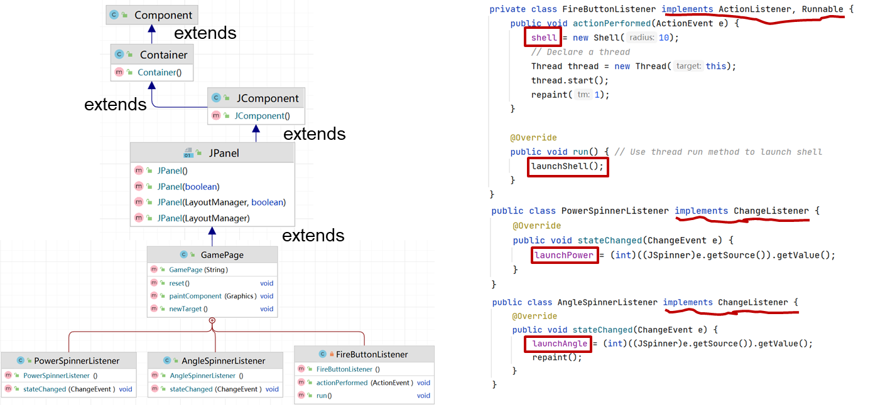
Game Structure - GamePage Class

Slide 15
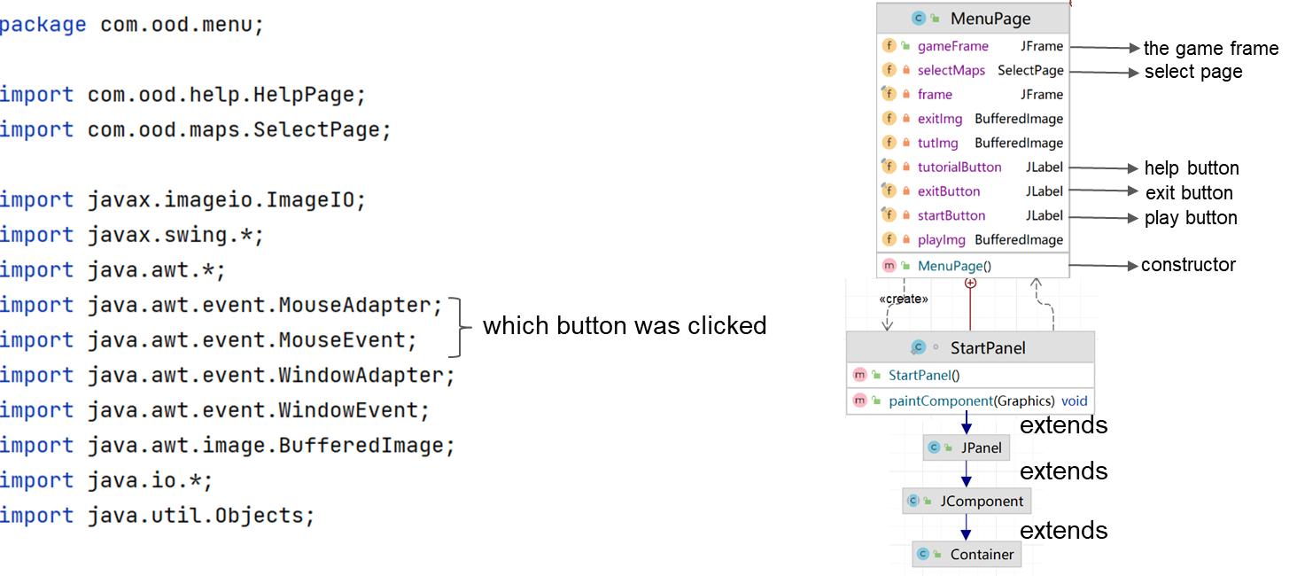
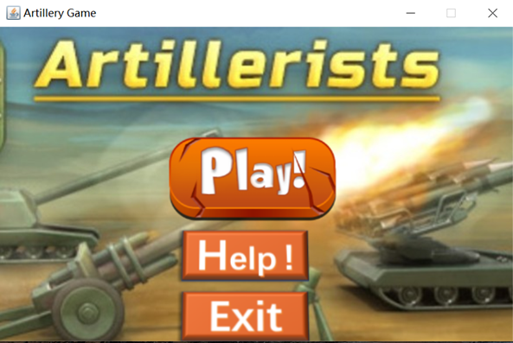
Game Structure - MenuPage Class

Slide 16
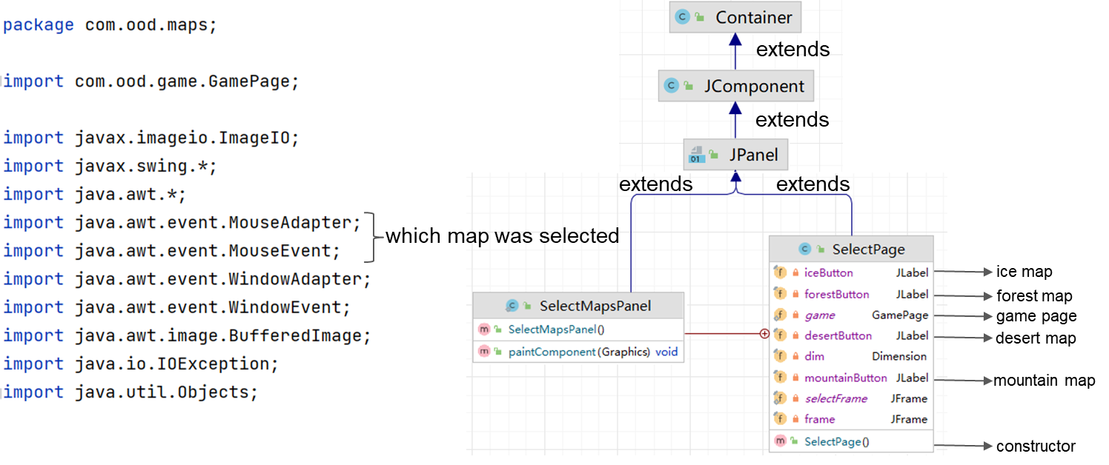
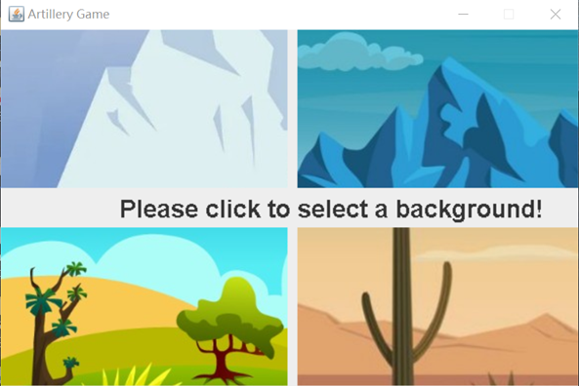
Game Structure - SelectPage Class

Slide 17
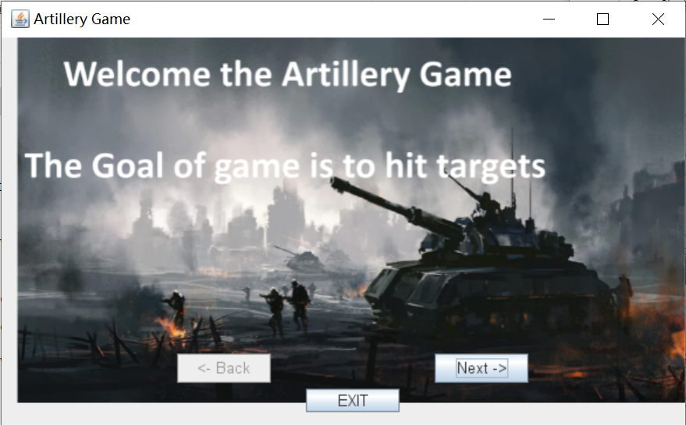
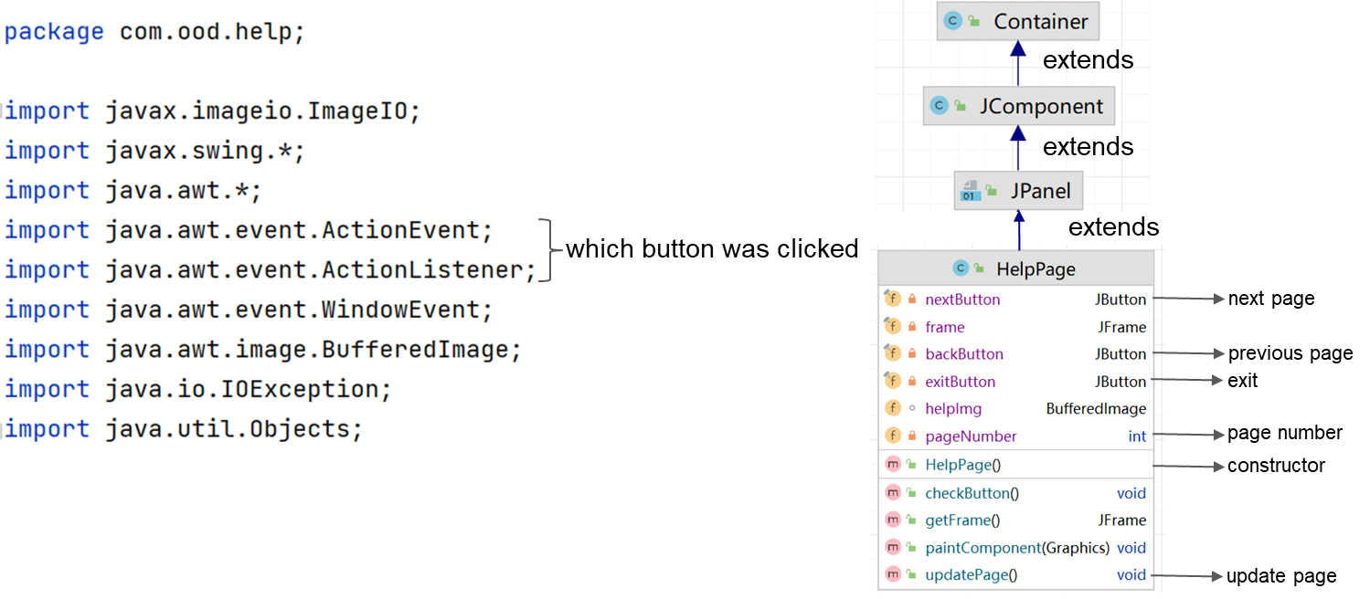
Game Structure - HelpPage Class

Slide 18
3. What have we learned

Slide 19
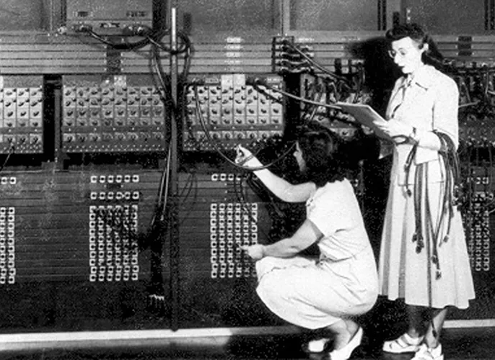
trace back to the original uses of computer:
Military-based calculations

Slide 20
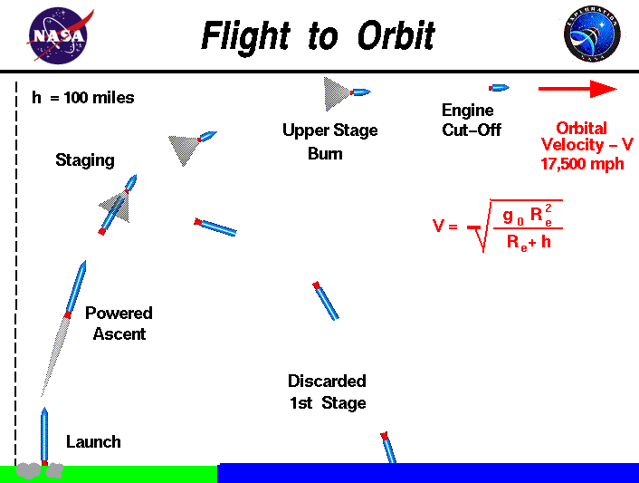
Calculate the trajectories of rockets,
simulate artillery of missile

Slide 21
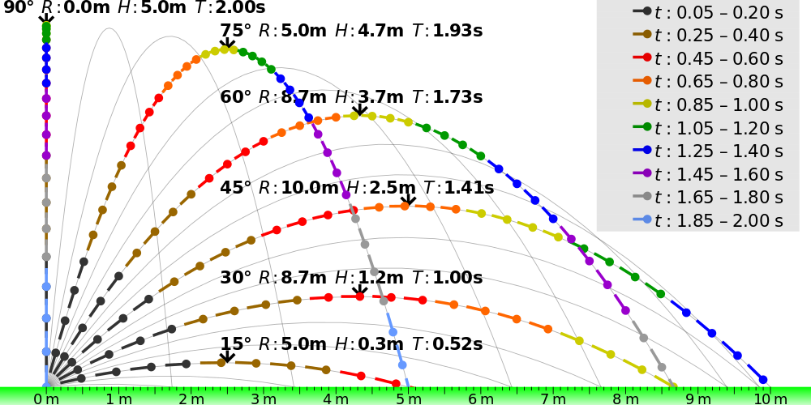
What have we learned
- Missile following a ballistic trajectory

Slide 22
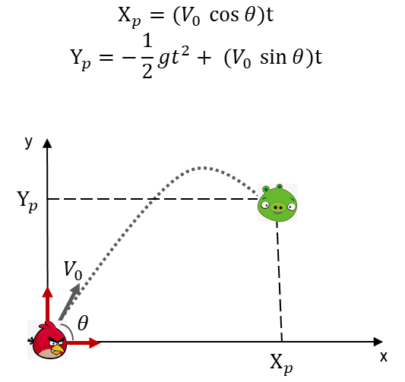
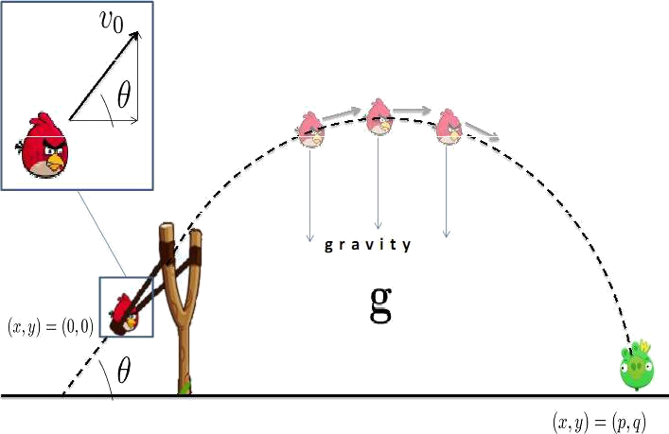
What have we learned
- Gravity-driven
- Parabolic curve

Slide 23
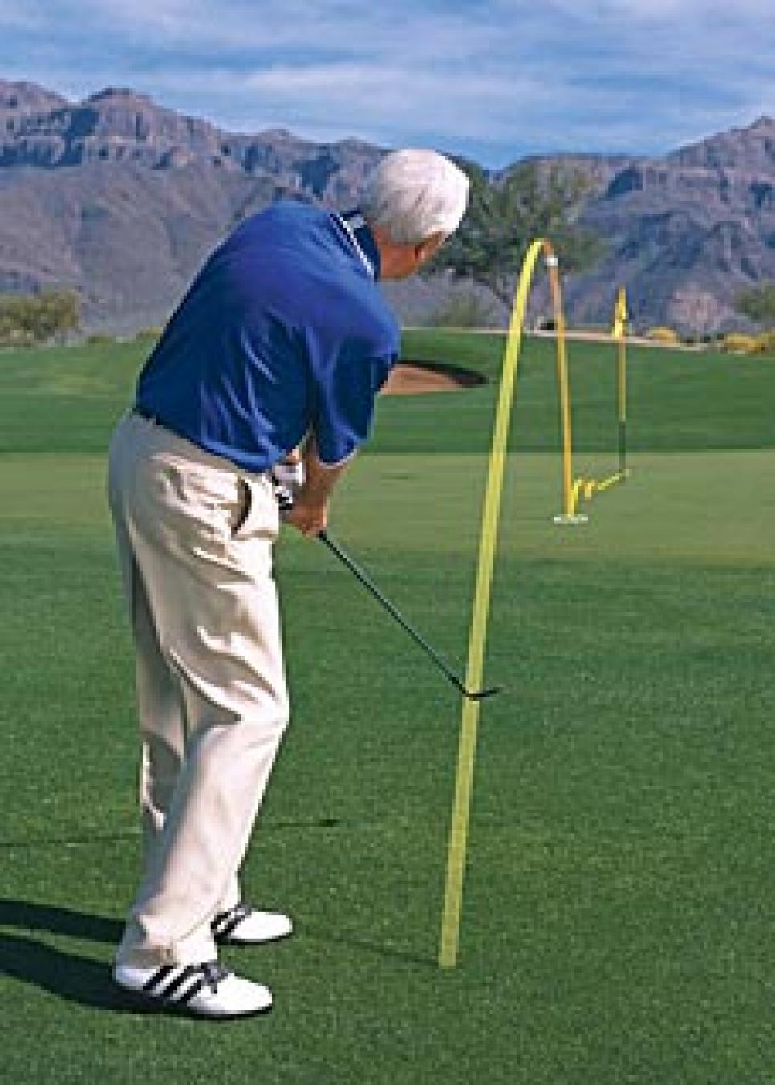
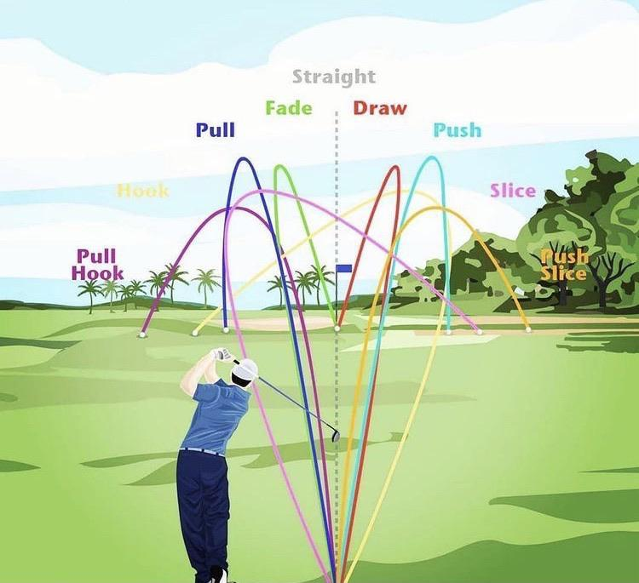
4. Interesting thing I’d like to mention
UX: when considering their next shot, visualize trajectory

Slide 24
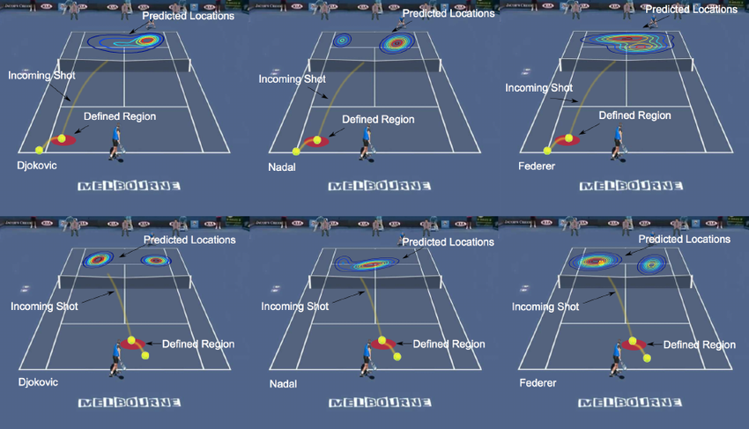
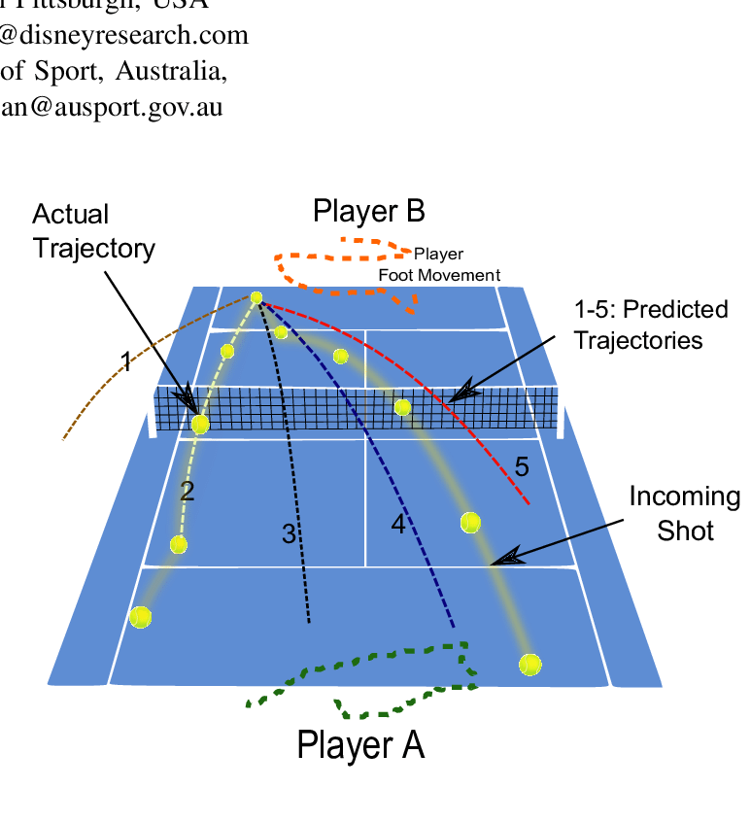
Interesting Thing
- this game designed to train their brain
- Predict what happens next

Slide 25

Interesting Thing - Mechanism of our brain
Our brain has evolved to anticipate the future
Our past experiences, miss, hit
anticipate future occurrences from patterns, ballistic trajectory
interact with the world around us.
Make the most appropriate decisions in a dynamic world.

Slide 26
Thank you

